Slide 1
Secure Data Hiding in Image Using Steganography
CAPSTONE PROJECT
Presented By:
Student Name : Karthick A
College Name & Department : KCG College of Technology
& CSE (CYBERSECURITY)

Slide 2
OUTLINE
Problem Statement
Technology used
Wow factor
End users
Result
Conclusion
Git-hub Link
Future scope

Slide 3
Problem Statement
With this Steganography project, users are able to hide and recover secret massages within images. It has a web-based user interface that is easy to understand and use. Built using HTML and CSS in the front end and JavaScript in the backend, everything works perfectly. The project is hosted as a website, which allows users to carry out steganographic tasks straight from their web browsers.

Slide 4
Technology used
Frontend:
HTML – Structure of the web pages
CSS – Styling and layout
Backend:
JavaScript – Handles encoding and decoding of messages within images
Canvas API – Used to manipulate image data for steganography
FileReader API – Reads uploaded images for processing
Hosting:
Hosted as a web-based application

Slide 5
Wow factors
1️⃣ Real-time Image Processing – Uses the Canvas API to manipulate image pixels directly in the browser, enabling instant encoding and decoding.
2️⃣ No External Dependencies – Fully functional using pure JavaScript, making it lightweight and easy to integrate.
3️⃣ User-Friendly Interface – Simple file upload and download process for seamless steganography without technical complexity.
4️⃣ Security through Obfuscation – The hidden message remains undetectable to the naked eye, ensuring privacy without altering the image visibly.
5️⃣ Completely Web-Based – No need for additional software; accessible from any device with a browser.

Slide 6
End users
1️⃣ Cybersecurity Enthusiasts – Individuals interested in secure communication and data hiding techniques.
2️⃣ Journalists & Whistleblowers – People who need to share sensitive information discreetly without attracting attention.
3️⃣ Military & Intelligence Agencies – Secure message transmission without obvious encryption traces.
4️⃣ Corporate & Business Users – Confidential document sharing without standard encryption methods.
5️⃣ General Users & Privacy Advocates – Anyone looking for a simple yet effective way to hide messages in images.

Slide 7

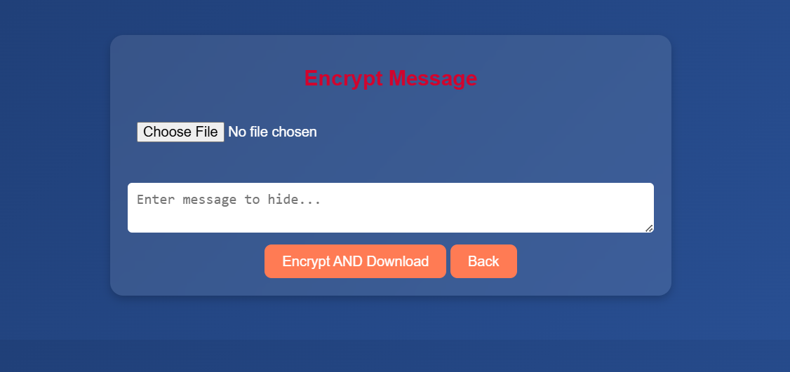
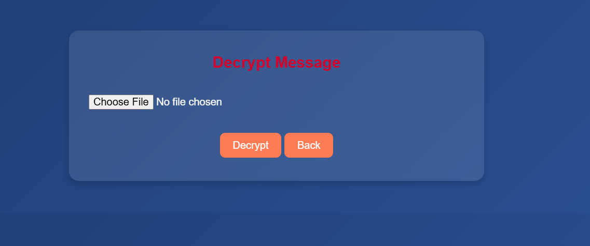
Results

Slide 8
Conclusion
This Steganography project provides a secure way to hide and retrieve messages within images using JavaScript and the Canvas API. It ensures message confidentiality without altering the image's visible quality. The web-based approach makes it easily accessible without additional software. With a simple user interface, it allows efficient encoding and decoding. This project enhances privacy and secure communication for users needing discreet data transmission. It is a lightweight and effective solution for cybersecurity and personal data protection.

Slide 9
GitHub Link
https://github.com/Karthick70928020/Aicte-intern-steganography.git

Slide 10
Future scope
1️⃣ Enhanced Security – Implement encryption algorithms to make the hidden message more secure.
2️⃣ Passcode Protection – Add an optional password to access the hidden message.
3️⃣ Multiple File Formats – Extend support for more image formats like JPEG, BMP, and GIF.
4️⃣ Audio & Video Steganography – Expand the project to hide messages in audio or video files.
5️⃣ AI-Based Detection Prevention – Use machine learning to ensure messages are undetectable by steganalysis tools.

Slide 11
THANK YOU

